Slide 1
Introduction to Shiny Part 1
Jim Hughes

Slide 2

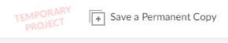
Presentation Resources
This presentation will be recorded
All presentation material located on GitHub
https://github.com/jhhughes256/pfe_shiny_intro
Workspace available on RStudioCloud
https://rstudio.cloud/project/1638785
Press in the top-right of the window
These are provided for working with the material offline
Includes several additional examples
You are welcome to follow along live

Slide 3
Summary
This Session
Why should I care about Shiny?
Shiny Framework
Inputs and Outputs
Deploying Apps
Next Session
UI Layouts
Reactivity
From R Script to App

Slide 4
Why Shiny?

Slide 5


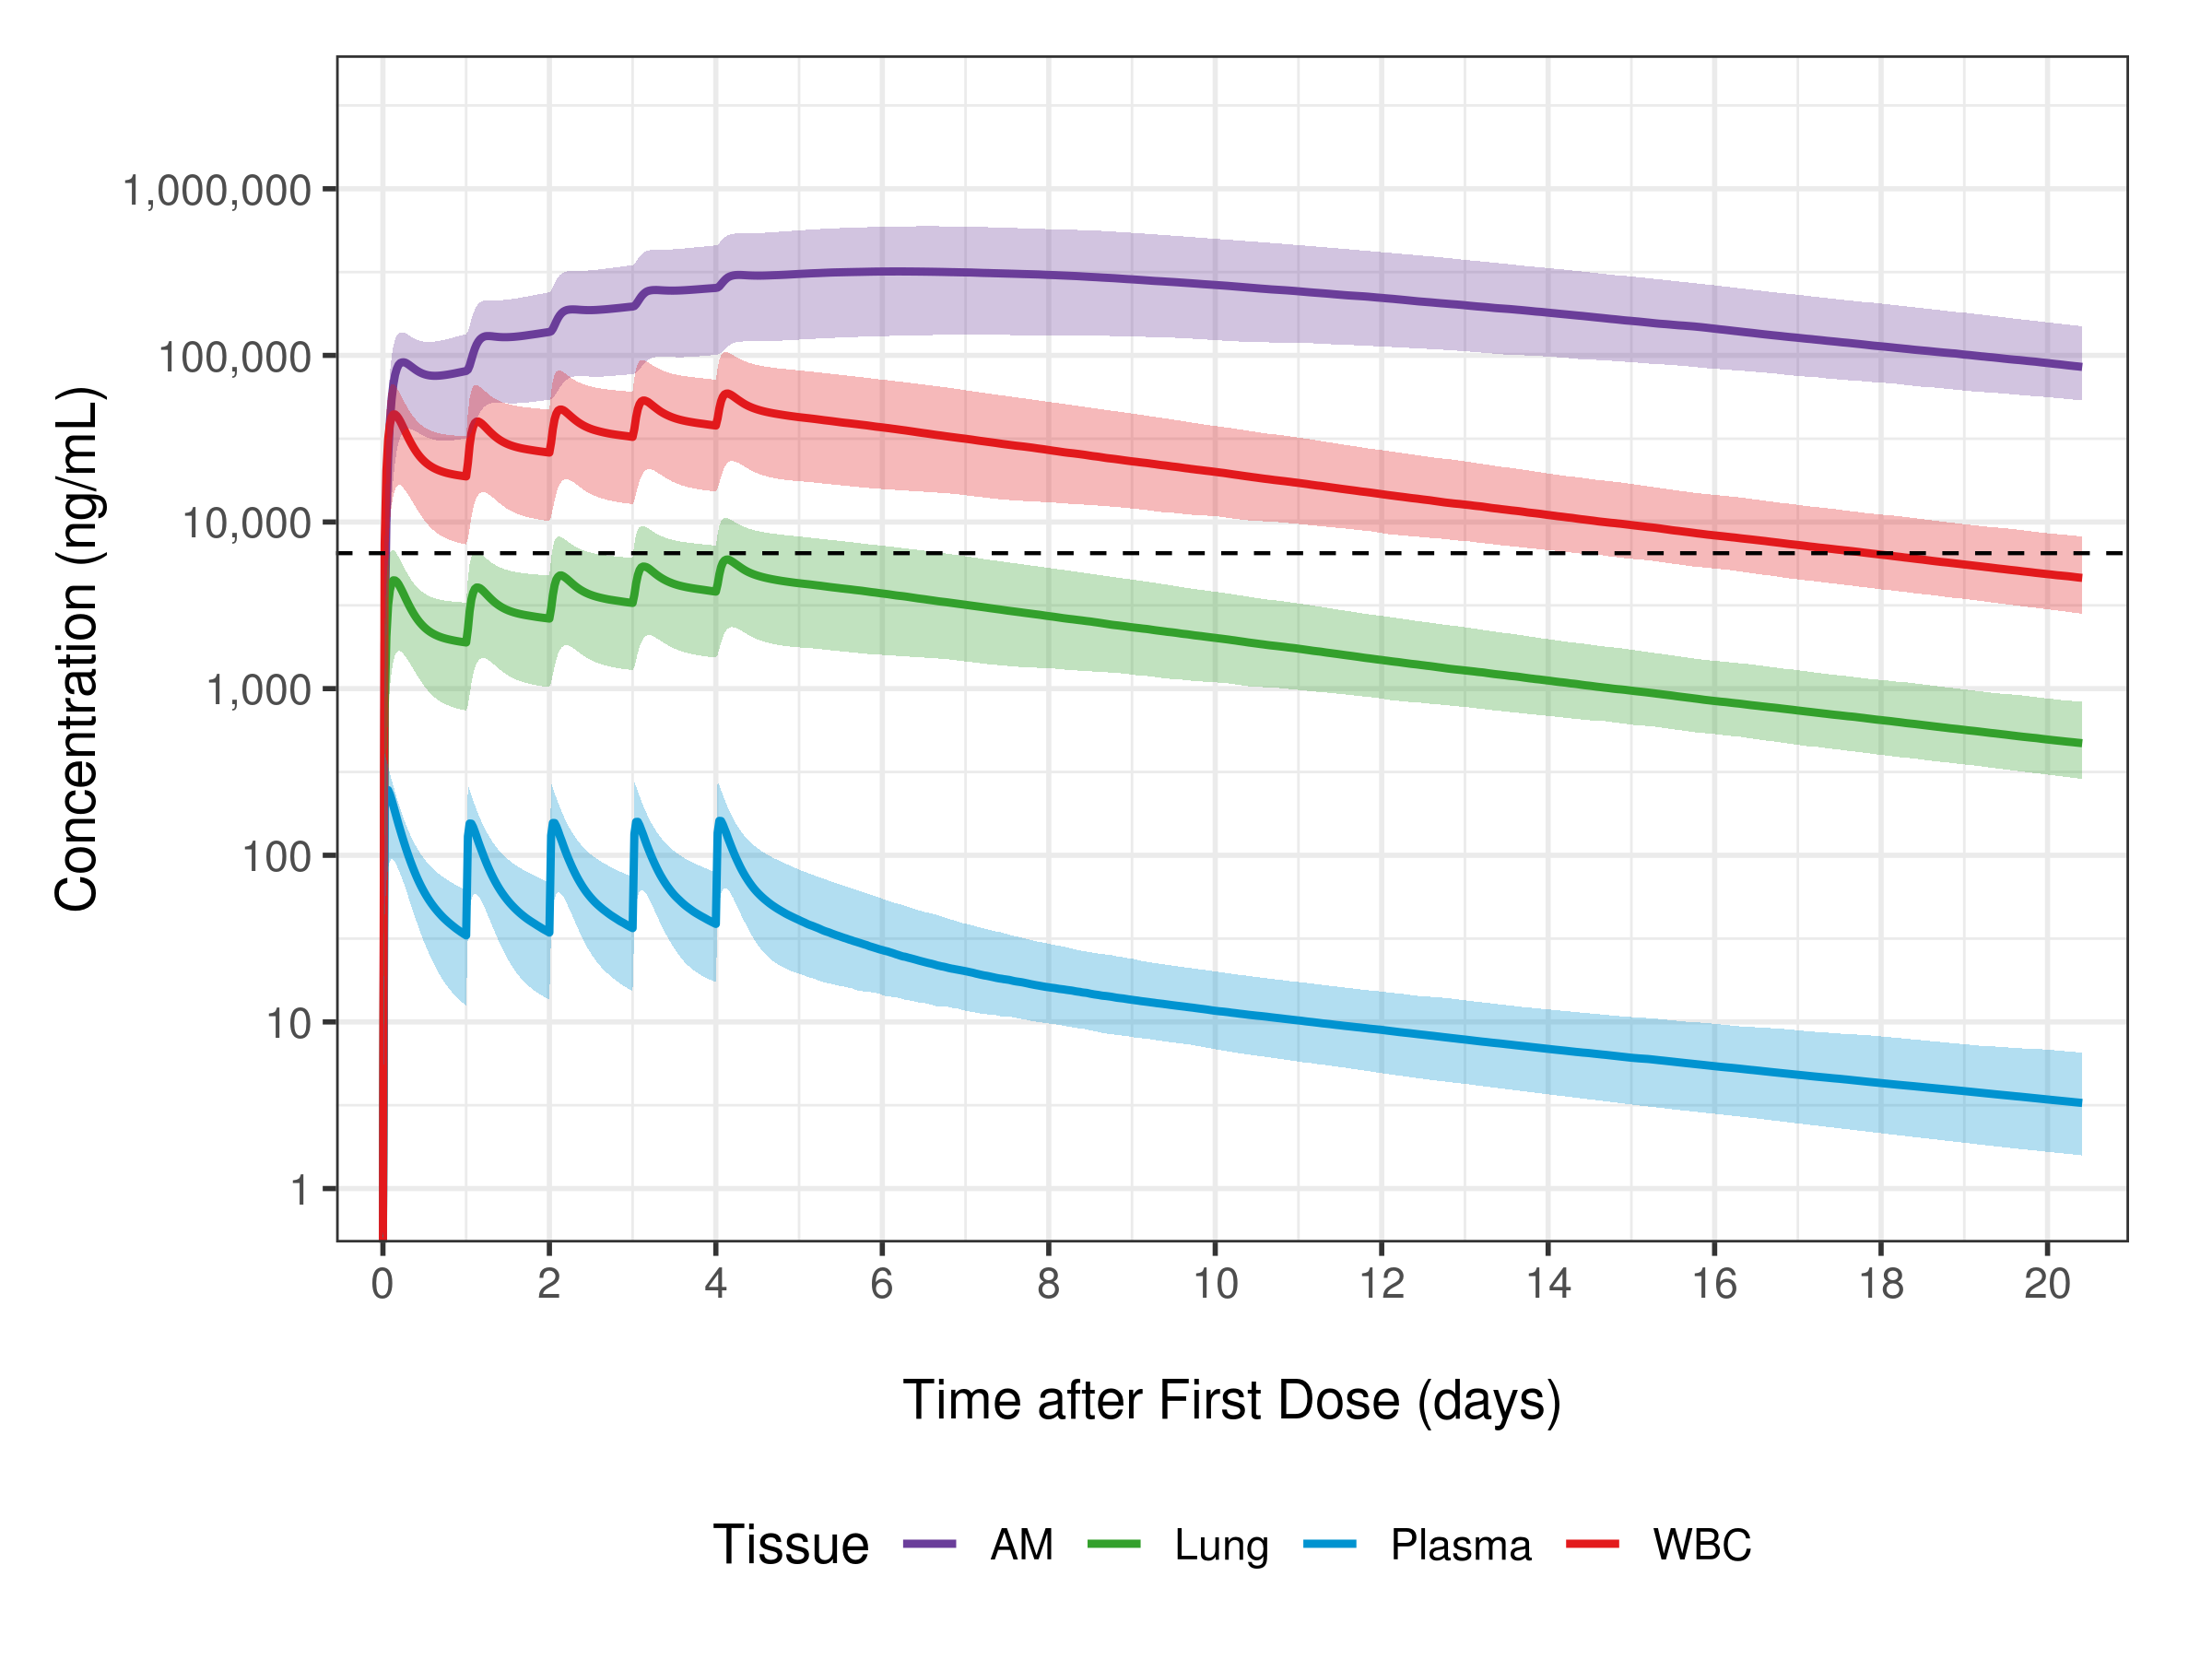

Does this sound familiar?
z^{z}
PKPD model simulations are presented to the team
A member of the team asks about a scenario that hasn’t been simulated
Everyone decides that the scenario is very important and will be needed to move forward with decisions
You note the scenario and plan to present it at the next meeting
z^{z}

Slide 6

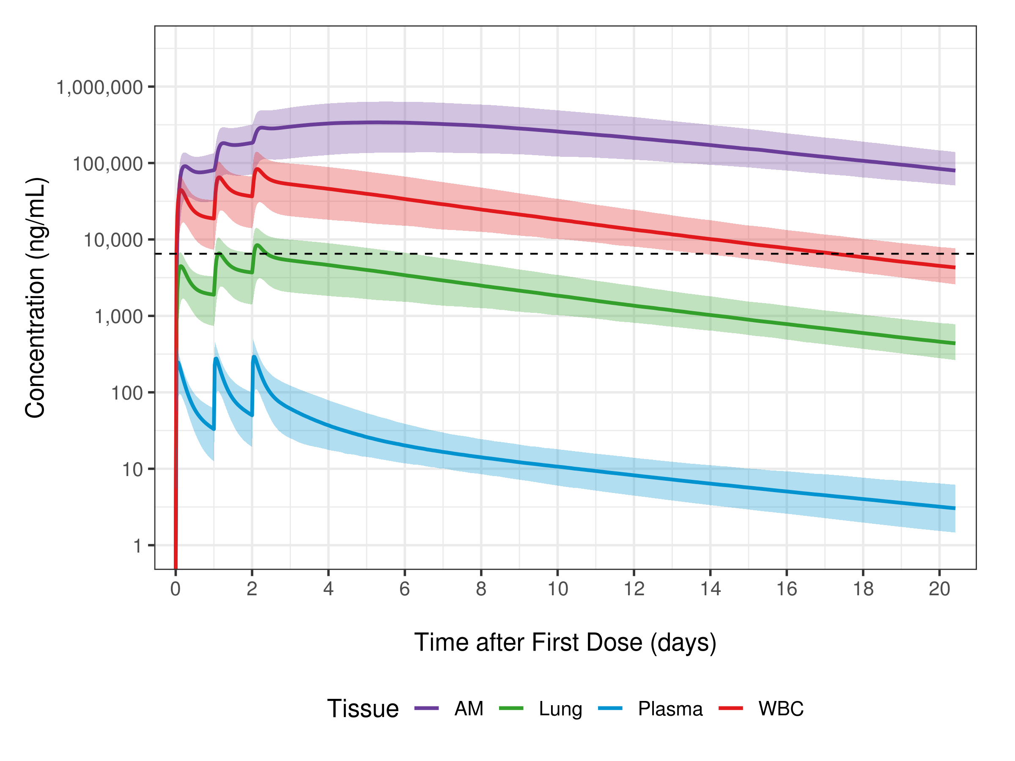
Does this sound familiar?
Several scenarios are simulated with a PKPD model
You’d like to simulate a separate scenario but…
You don’t understand the code
You can’t get the code to run
The colleague who wrote the code is too busy (or left the company!)
dense_code.R
Scenario 1
Scenario 2

Slide 7
Shiny can help!
Shiny is an R package for making interactive web applications
Users interact with a web page
Based on input your R code runs in the background
Presents the R code output to the user
Can be as simple or complex as required
https://rsc.pfizer.com/content/17
https://azpksim.pfizer.com

Slide 8
Shiny Framework

Slide 9

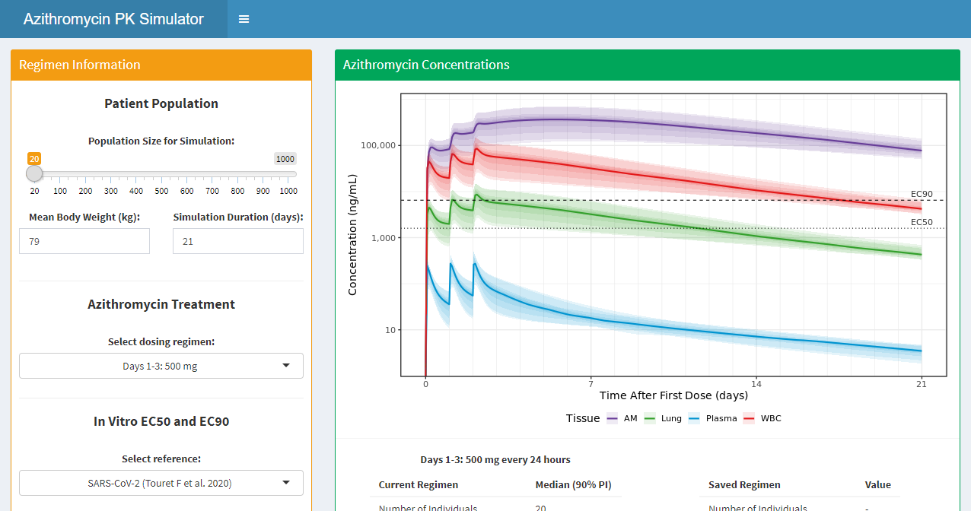

Shiny Architecture
Every Shiny application displays a webpage. This is provided by a machine in the background that is running R.
Local computer
Remote server
Local web browser

Slide 10


Shiny Architecture
The R code runs on the server and sends HTML the browser.
Server R code
User Interface

Slide 11
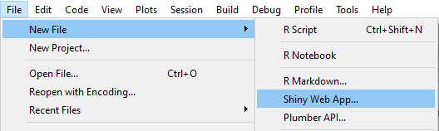

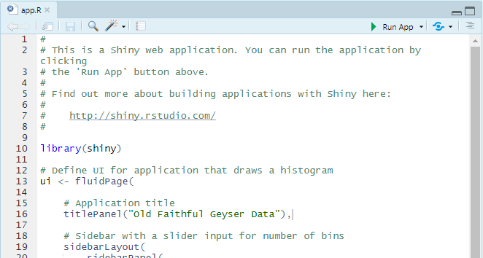
RStudio and Shiny
Navigate to RStudio Cloud or RStudio Desktop
Create a new Shiny Web App
File > New File > Shiny Web App
Give it any name you like
Press the run button and explore the app
Look at the example app code
What code seems familiar?
What code is new to you?
Resources
RStudio Cloud
https://rstudio.cloud/project/1638785
Press Save a Permanent Copy
Session Materials on GitHub
https://github.com/jhhughes256/pfe_shiny_intro

Slide 12
Shiny App Structure
library(shiny)
ui <- fluidPage()
server <- function(input, output) {}
shinyApp(ui = ui, server = server)
R code describing the UI
When run it generates HTML
R code responsible for computation i.e. simulation
R function that puts the two pieces together!

Slide 13
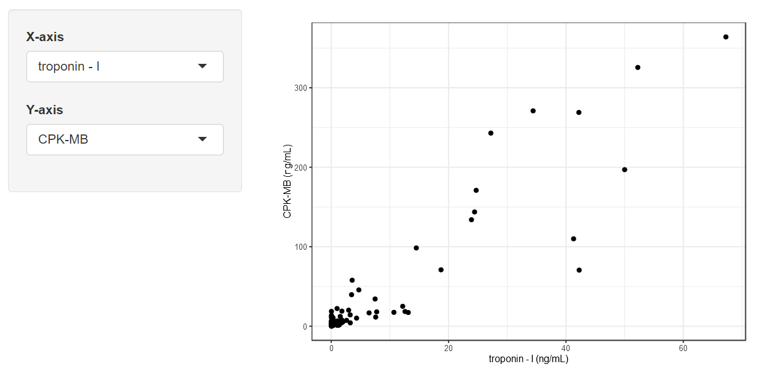
eICU Application – Example 1
A small subset of an open-source de-identified ICU electronic health record data from 200,000+ admissions
Contains information on admission diagnosis and lab values
References
Johnson, A., Pollard, T., Badawi, O., & Raffa, J. (2019). eICU Collaborative Research Database Demo (version 2.0). PhysioNet. https://doi.org/10.13026/gxmm-es70
Goldberger, A., et al. (2000). PhysioBank, PhysioToolkit, and PhysioNet: Components of a new research resource for complex physiologic signals. Circulation [Online]. 101 (23), pp. e215-e220.
eICU_app_01.R

Slide 14
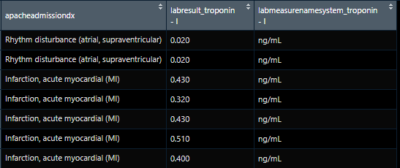
Original Code
Data is in wide format
Row for each patient
Column for each lab value
Column for each lab unit
# Define plot columns
plot_x <- "troponin - I"
plot_y <- "CPK-MB"
# Create data for exploratory graphics
plotData <- tibble(
xaxis = pull(eicuData, paste0("labresult_", plot_x)),
yaxis = pull(eicuData, paste0("labresult_", plot_y)),
xunit = pull(eicuData, paste0("labmeasurenamesystem_", plot_x)),
yunit = pull(eicuData, paste0("labmeasurenamesystem_", plot_y))
) %>% filter(!is.na(xaxis) & !is.na(yaxis))
xunit <- unique(plotData$xunit)
yunit <- unique(plotData$yunit)
# Create exploratory graphics
p <- NULL
p <- ggplot(plotData)
p <- p + geom_point(aes(x = xaxis, y = yaxis))
p <- p + labs(
x = paste0(plot_x, " (", xunit, ")"),
y = paste0(plot_y, " (", yunit, ")"))
p
input
output
eicuData

Slide 15
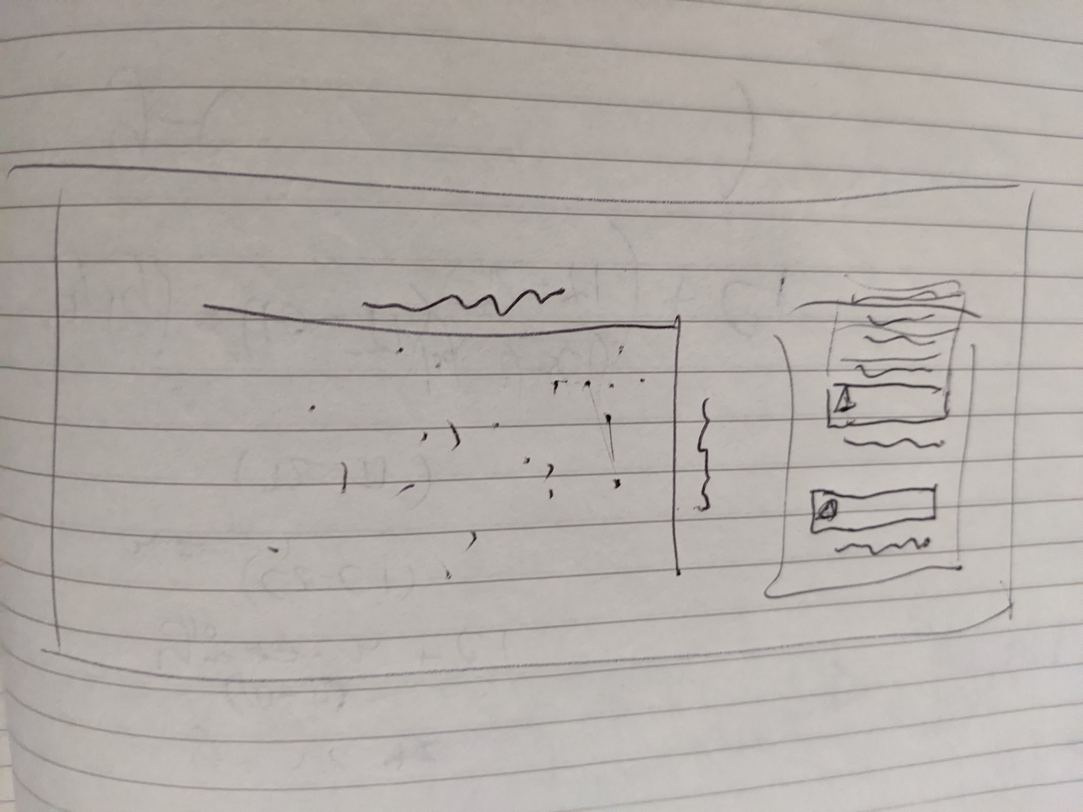
UI Mockup
When designing UI it can help to create a mockup of your app
Feel free to use:
Pen and paper
Paint / Balsamiq Mockup
Powerpoint
Think about:
How the app will be used
UI designs you like
UI designs you dislike
input
output

Slide 16
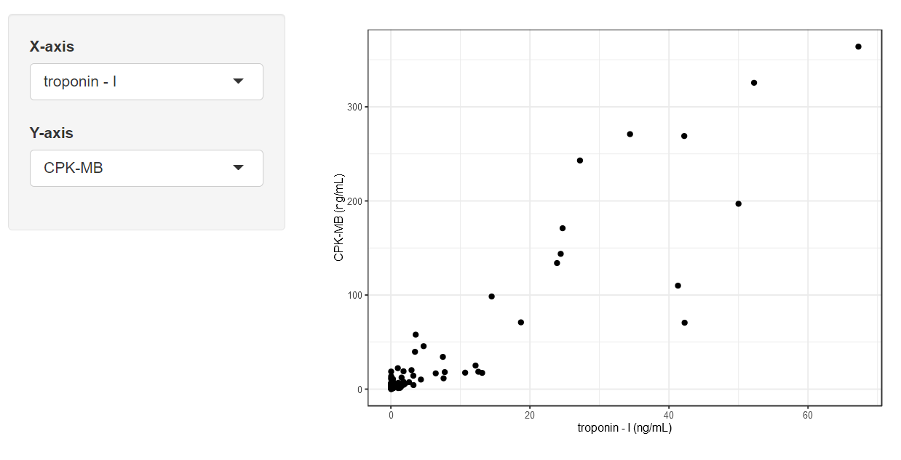
UI Structure
app_ui <- fluidPage(
sidebarLayout(
# Left panel (sidebar, inputs)
sidebarPanel(
selectInput("plot_x", "X-axis",
choices = list("albumin", "alkaline phos.", ...),
selected = "troponin - I"
), # selectInput
selectInput("plot_y", "Y-axis",
choices = list("albumin", "alkaline phos.", ...),
selected = "CPK-MB"
) # selectInput
), # sidebarPanel
# Right panel (main area, outputs)
mainPanel(
plotOutput("plot")
) # mainPanel
) # sidebarLayout
) # fluidPage

Slide 17
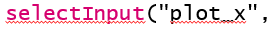
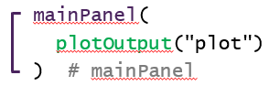
Server Structure
server <- function(input, output) {
# Define plot output
output$plot <- renderPlot({
plotData <- tibble(
xaxis = pull(eicuData, paste0("labresult_", input$plot_x)),
yaxis = pull(eicuData, paste0("labresult_", input$plot_y)),
...
) %>% filter(!is.na(xaxis) & !is.na(yaxis))
p <- NULL
p <- ggplot(plotData)
p <- p + geom_point(aes(x = xaxis, y = yaxis))
...
p
})
}
A read-only list of values
sent from the UI
input
renderPlot
Prepares the plot so that it can be output to the UI
output
A write-only list of values
sent to the UI

Slide 18
Inputs and Outputs

Slide 19
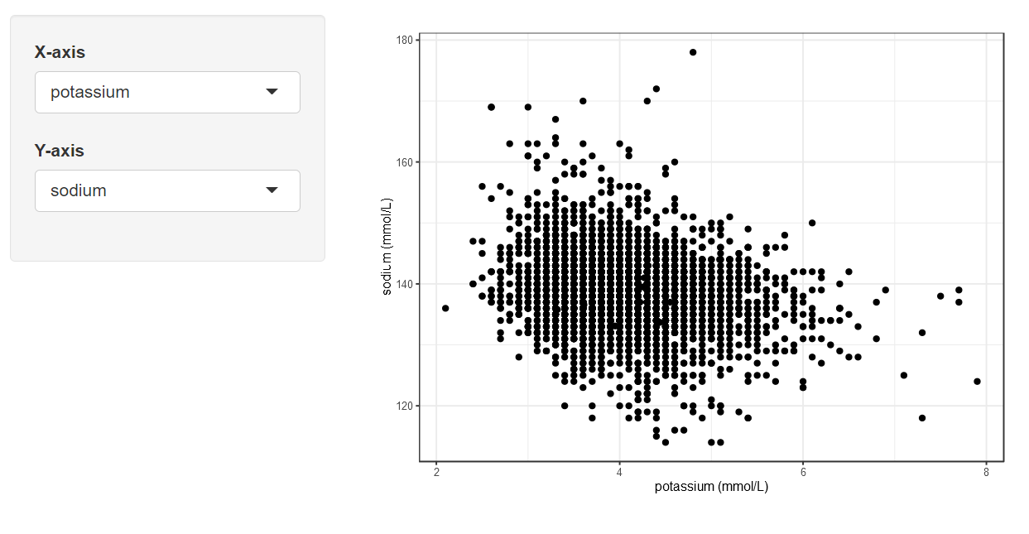
Reactivity Basics
input$plot_x = "troponin - I"
input$plot_y = "CPK-MB"
server
output$plot
output$plot
input$plot_x = "potassium"
input$plot_y = "sodium"
server

Slide 20
eICU Application – Example 2
How can we better distinguish this relationship?
Could add an option to view the x- and y-axis on a log-scale
What will this require?
A new input
checkboxInput(inputId, label, value)
New server code
p + scale_x_log10()
eICU_app_02.R shows the solution
eICU_app_01.R

Slide 21
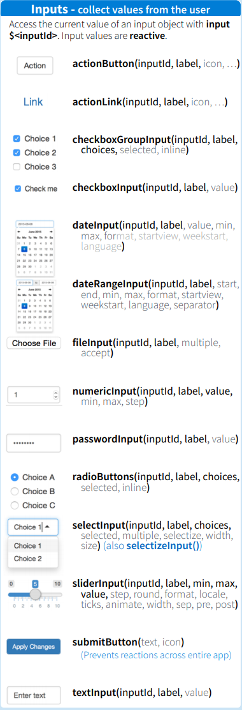
Inputs
Several inputs to choose from
Added in UI/server pairs
*Input("id") function in the UI creates an input
input$id uses that input in the server
Provide user input in different forms
Numeric (0, 1, 2, …)
numericInput, sliderInput
Text ("plot_x", "plot_y")
textInput, selectInput, radioButtons
Logical (TRUE | FALSE)
checkboxInput

Slide 22
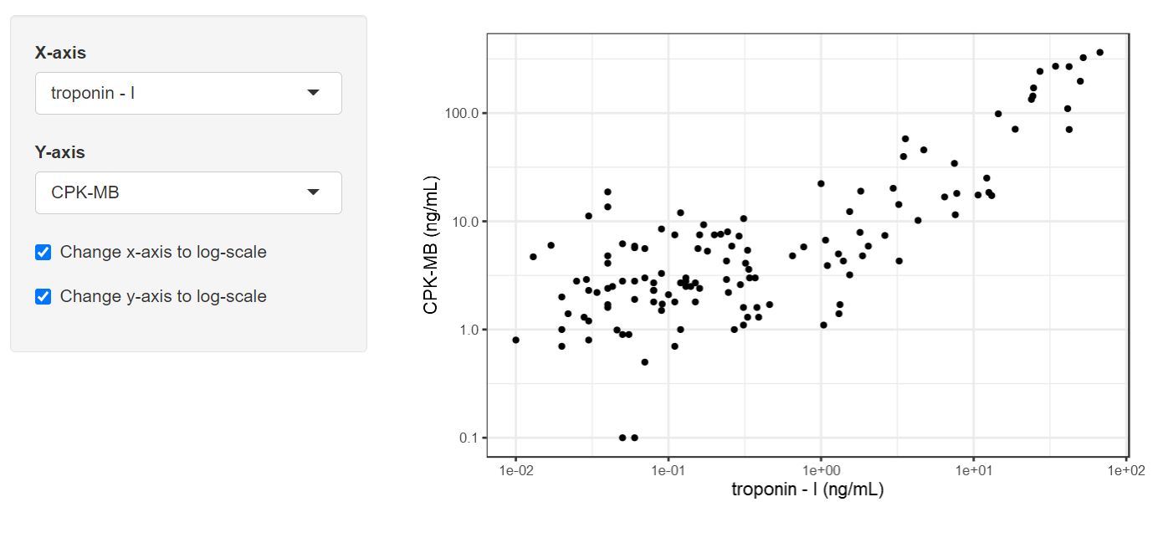
eICU Application – Example 3 & 4
Easier to distinguish between points
Still difficult to distinguish between diagnoses
Could colour points by diagnosis & add an input to change the alpha of the points in the plot
sliderInput(inputId, label, value, min, max)
eICU_app_03.R shows the solution
Could add another select input to view different diagnoses
selectInput(inputId, label, choices)
eICU_app_04.R shows the solution
eICU_app_02.R

Slide 23
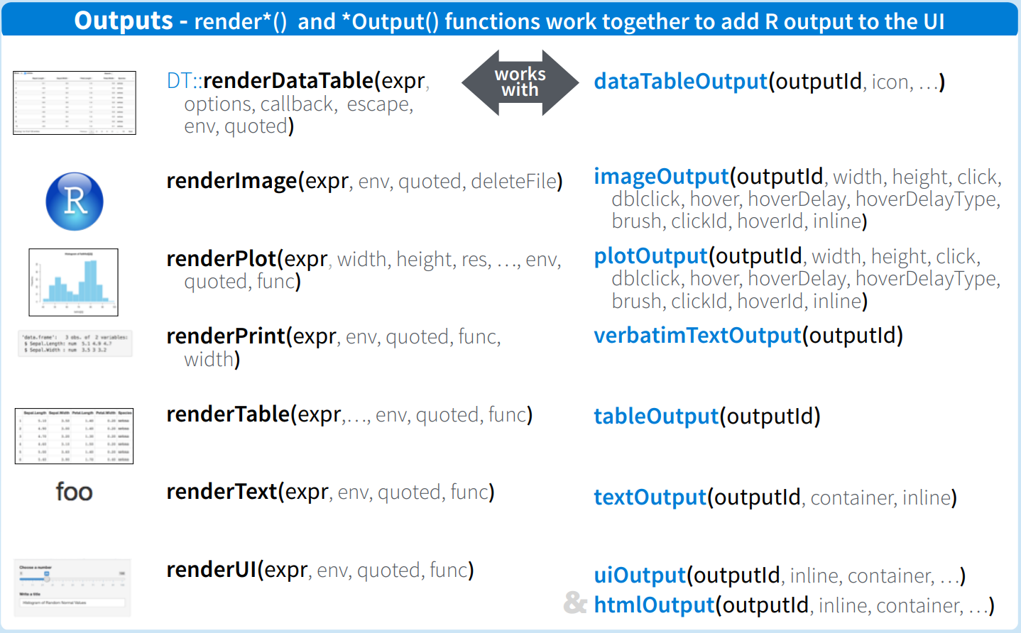
Outputs
Several outputs to choose from
Added in server/UI pairs
render*() assigns the server code to an output using output$id
*Output("id") uses that output in the UI
Provide server output of several types
Plots
renderPlot / plotOutput
Tables
renderTable / tableOutput
renderDataTable / dataTableOutput
Text, Images and even UI too!

Slide 24
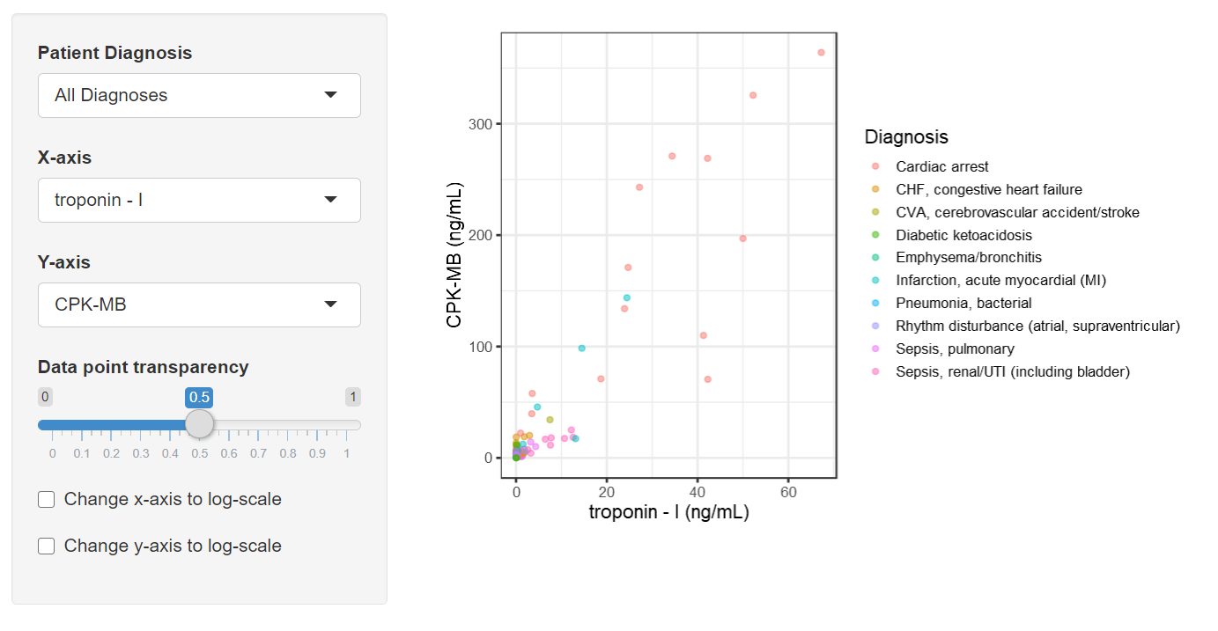
eICU Application – Example 5 & 6
The visuals are nice, but someone may be interested in seeing the actual values
Could add a new output displaying the data in a table
output$table <- renderDataTable({...})
eICU_app_05.R shows the solution
Not all users may want to see it though
Could use a checkbox to show/hide it
checkboxInput(inputId, label, value)
eICU_app_06.R shows the solution
eICU_app_04.R

Slide 25
Deploying Apps

Slide 26
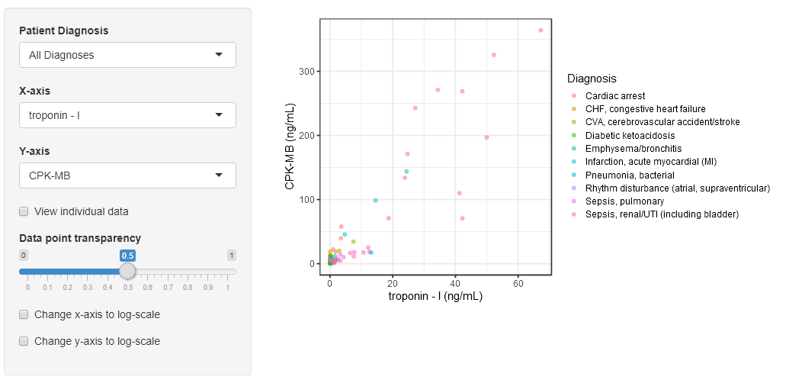
Deploying Shiny Apps
app.R
Local computer
Local web browser

Slide 27


Deploying Shiny Apps
Note: It is important to name your R file as “app.R” prior to deploying.
Local computer
app.R
Deploy App
Remote server
Local web browser

Slide 28
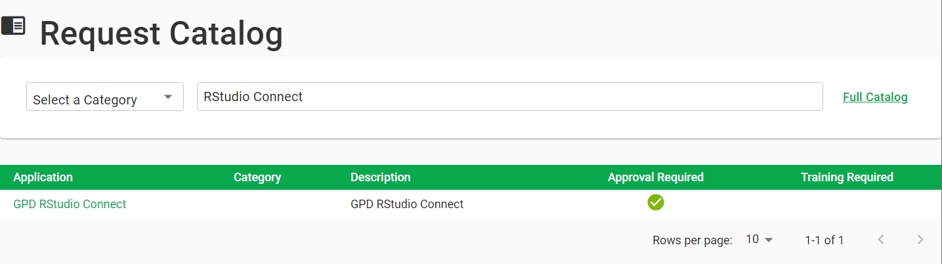
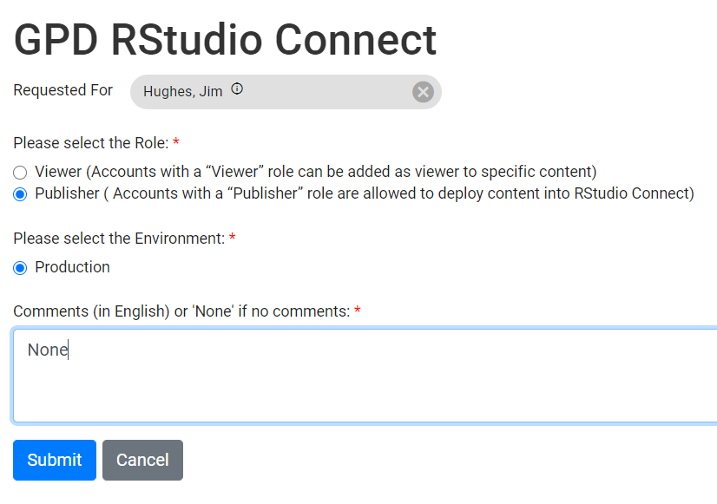
Deploying Shiny Apps
Request access to RStudio Connect via “Request Manager” http://requestmanager.pfizer.com/
Search for RStudio Connect
Click the box next to “GPD RStudio Connect”
Click “Checkout”
Select Role “Publisher”
Select Environment “Production”
Add the text “None” in the Comments box
Click Continue
Submit Request

Slide 29
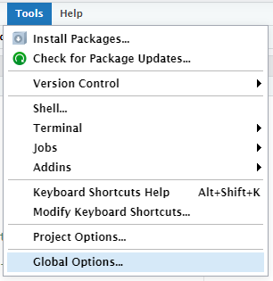
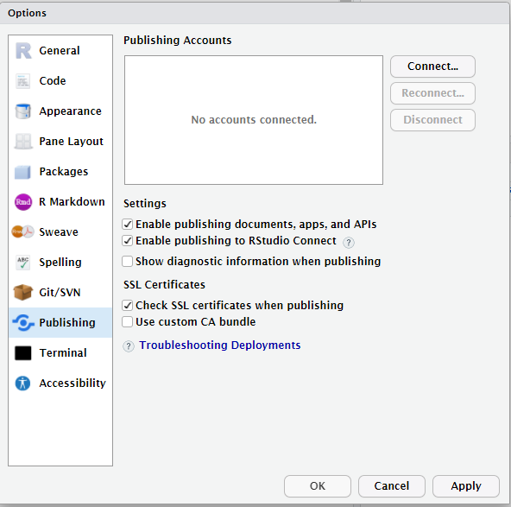
Deploying Shiny Apps
Once you have access, open RStudio v1.2 with R-3.6.1
If you don’t have these installed instructions are here
Tools > Global Options > Publishing
Click the “Connect” button.
Select “RStudio Connect”.
Server is: https://rsc.pfizer.com/
Enter NT username and password.
Click “Connect” on the next screen.
Close the browser.
Click “Connect Account” back in RStudio.

Slide 30
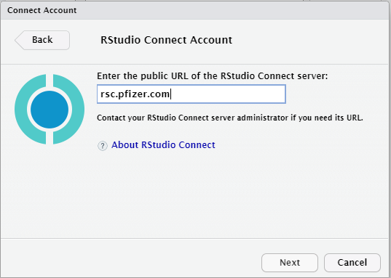
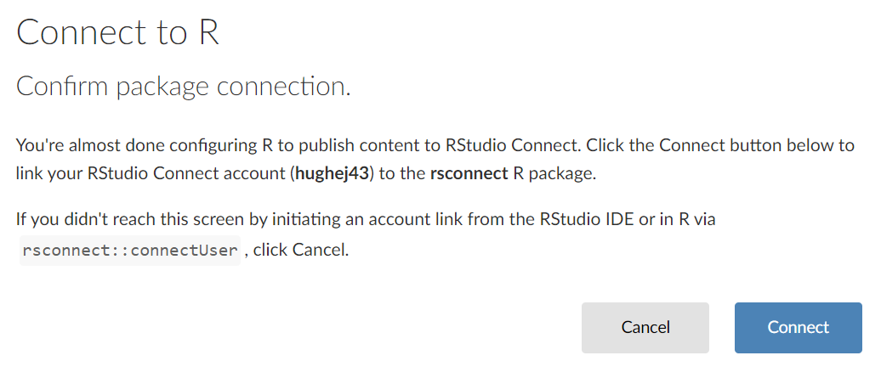
Deploying Shiny Apps
Once you have access, open RStudio v1.2 with R-3.6.1:
Tools > Global Options > Publishing
Click the “Connect” button.
Select “RStudio Connect”.
Server is: https://rsc.pfizer.com/
Enter NT username and password.
Click “Connect” on the next screen.
Close the browser.
Click “Connect Account” back in RStudio.
Now you can publish content to RStudio Connect.

Slide 31
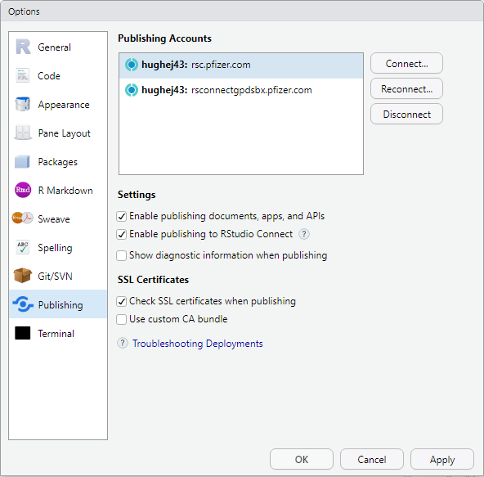
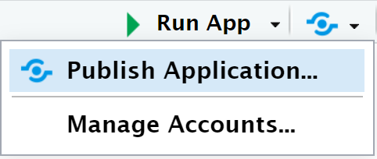
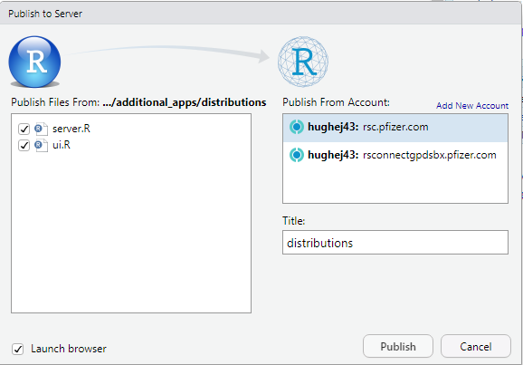
Deploying Shiny Apps
Once you have access, open RStudio v1.2 with R-3.6.1:
Tools > Global Options > Publishing
Click the “Connect” button.
Select “RStudio Connect”.
Server is: https://rsc.pfizer.com/
Enter NT username and password.
Click “Connect” on the next screen.
Close the browser.
Click “Connect Account” back in RStudio.
Now you can publish content to RStudio Connect.

Slide 32
Summary

Slide 33
Shiny Summary
Shiny is a tool that allows users to interact with R code through a user interface
Well suited for presenting complex code in a simple form
The user interface runs in a local browser
The R code runs in the background waiting for the user to interact with the UI
The UI is defined with nested UI functions
ui <- fluidPage(
titlePanel("My App"),
sidebarLayout(
sidebarPanel(numericInput(...)),
mainPanel(plotOutput(...))
)
)
The server is defined as a function with arguments input and output
server <- function(input, output) {
}
Inputs and outputs are defined in pairs
*Input("in") → input$in
output$out → *Output("out")
Correct render function for each UI output
renderPlot(…) → plotOutput(…)
Deploying apps to a remote server like RStudio Connect enables sharing of apps

Slide 34
Acknowledgements
RStudio Connect/Shiny SME Team
Patanjali Ravva
Satoshi Shoji
Mike K Smith
Jason Williams

Slide 35
Additional Resources
Shiny SME Sharepoint
https://pfizer.sharepoint.com/sites/GPMx/SitePages/R-Shiny.aspx
Basic RStudio Training Resources
Written Shiny tutorial
https://shiny.rstudio.com/tutorial/written-tutorial/lesson1/
Video Shiny tutorial
https://vimeo.com/131218530
Shiny Package Cheat Sheet
https://shiny.rstudio.com/images/shiny-cheatsheet.pdf
CP/PMx-specific Shiny literature
https://ascpt.onlinelibrary.wiley.com/doi/full/10.1002/psp4.21
Basic-Advanced Shiny articles
https://shiny.rstudio.com/articles/
Intermediate-Advanced Shiny books These are both in development planned to be published by end of 2020
Mastering Shiny
https://mastering-shiny.org/
Engineering Production-Grade Shiny Apps
https://engineering-shiny.org/

